Slide 1
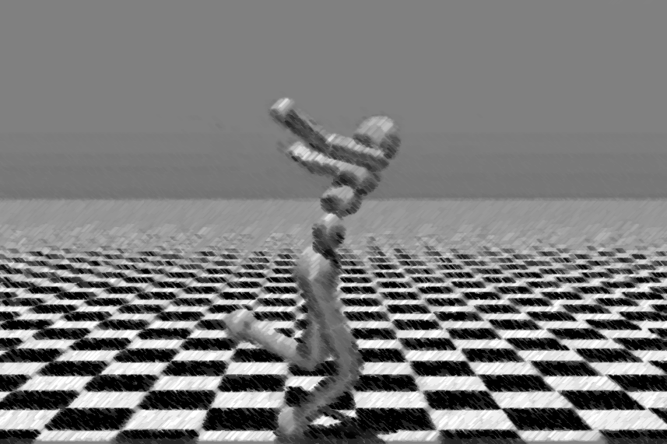

Humanoid Walking A Reinforcement Learning Case Study
Master in Data Science and Engineering
Advanced Topics on Intelligent Systems
_ Francisco Pinto, João Vieira _
13 / 11 / 2025

Slide 2
TABLE OF CONTENTS
01
02
03
Project Idea
Problem Representation
Expected Results
2

Slide 3

1. Project Idea - Motivation
Hands On Learning
To see how it works
Limitations and Benefits
Deal with a complex task
To have fun
3

Slide 4
1. Project Idea – Key Points
Choose a Problem – Humanoid Walk
Apply RL Algorithms
Use Proximal Policy Optimization (PPO)
Based on Stable Baseline 3 (SB3)
Use the Mujoco Environment
Incremental approach of difficulty:
Simple scenario (achieve walking)
Intermediate scenario (walk to a certain destination)
Complex scenario (walk and climb stairs)
https://gymnasium.farama.org/environments/mujoco/humanoid/
4

Slide 5
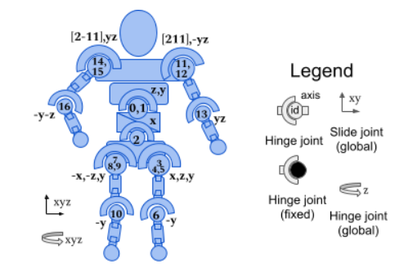
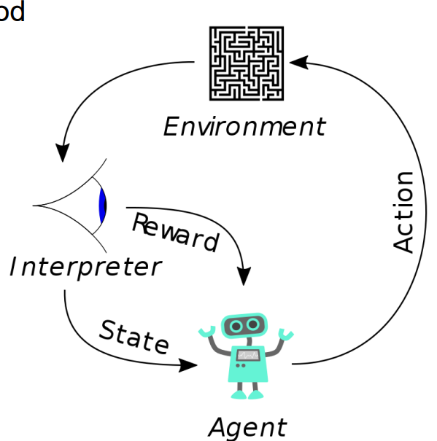
2. Problem Representation
The Action Space
The action space is a Box(-0.4, 0.4, (17,), float32). An action represents the torques applied at the hinge joints, it as 17 different elements.
The Observation Space
The observation space is a Box(-Inf, Inf, (348,), float64) they represent different groups of elements with a total 348.
The Reward
The total reward is -> reward =
healthy_reward + forward_reward - ctrl_cost - contact_cost
https://gymnasium.farama.org/environments/mujoco/humanoid/
5

Slide 6
2. Problem Representation
The Observation Space (In Detail)
The observation space consists of the following parts (in order):
qpos (22 elements by default): The position values of the robot’s body parts.
qvel (23 elements): The velocities of these individual body parts (their derivatives).
cinert (130 elements): Mass and inertia of the rigid body parts relative to the center of mass, (this is an intermediate result of the transition). It has shape 13*10 (nbody * 10). (cinert - inertia matrix and body mass offset and body mass)
cvel (78 elements): Center of mass based velocity. It has shape 13 * 6 (nbody * 6). (com velocity - velocity x, y, z and angular velocity x, y, z)
qfrc_actuator (17 elements): Constraint force generated as the actuator force at each joint. This has shape (17,) (nv * 1).
cfrc_ext (78 elements): This is the center of mass based external force on the body parts. It has shape 13 * 6 (nbody * 6) and thus adds another 78 elements to the observation space. (external forces - force x, y, z and torque x, y, z)
Note: nbody is the number of bodies in the robot, and nv is the number of degrees of freedom (= dim(qvel)).
https://gymnasium.farama.org/environments/mujoco/humanoid/
6

Slide 7
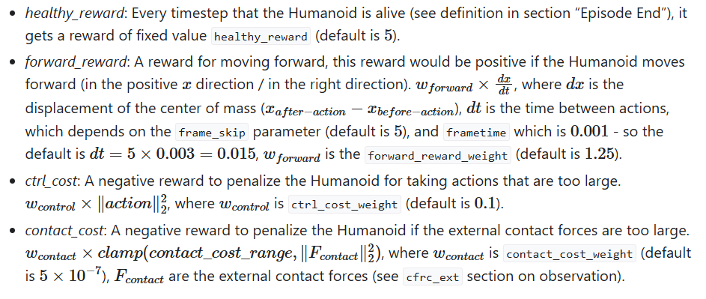
2. Problem Representation
The Reward (In Detail)
The total reward is -> reward = healthy_reward + forward_reward - ctrl_cost - contact_cost
https://gymnasium.farama.org/environments/mujoco/humanoid/
7

Slide 8
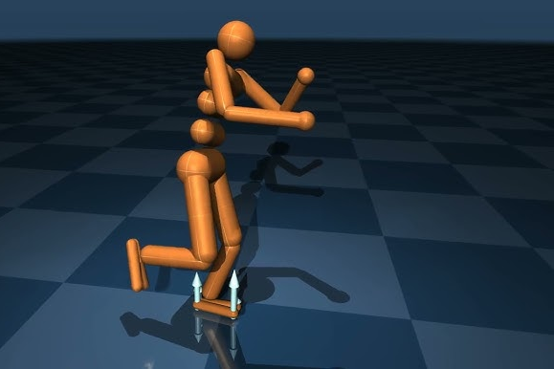
3. Expected Results
Learn to Walk
Learn to Walk To a Destination
Learn to Walk and Climb
Observe and document the rate of learning
8

